Slide 1












Sports Basics IPL 2024 Magazine Insights
Presented By : Bilal Ahmed

Slide 2
Introduction
"Sports Basics" is a sports blog company that recently entered the space. They aimed to increase traffic to their website by releasing a special edition magazine focusing on IPL 2024.
The magazine aims to provide captivating insights and facts for fans, analysts, and teams based on data from the past three years.
Chief editor Tony Sharma oversees this publication, emphasizing the importance of data analytics. He enlisted the expertise of Peter Pandey, a journalist in his team known for his data proficiency and passion for cricket.

Slide 3
Problem Statement
The problem at hand is to boost website traffic by offering valuable insights and facts for IPL 2024.
With Tony Sharma's advocacy for data analytics and Peter Pandey's expertise, the team is poised to provide comprehensive analysis and captivating content for cricket enthusiasts.

Slide 4
Insights Overview
Primary Insights:
In-depth analysis unveils top players and teams in IPL over the past three years.
Key metrics include batting and bowling performance, team winning percentages, and successful chase rates.
Secondary Insights
Predictive analytics anticipate top players, qualifying teams, and the tournament outcome for IPL 2024.

Slide 5
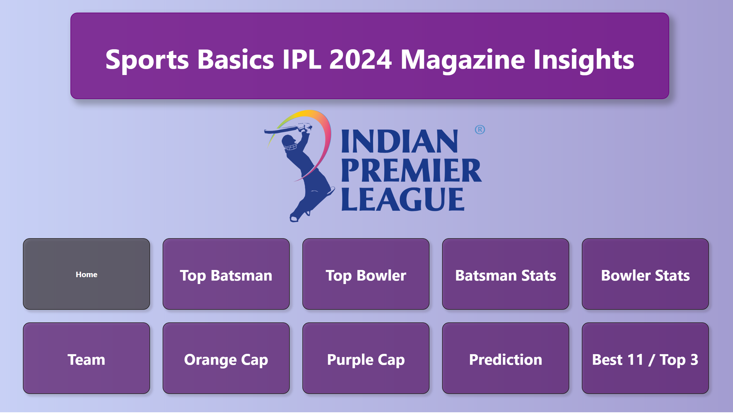
Home
Notes:
textbox
No alt text provided
image
No alt text provided
pageNavigator
No alt text provided

Slide 6
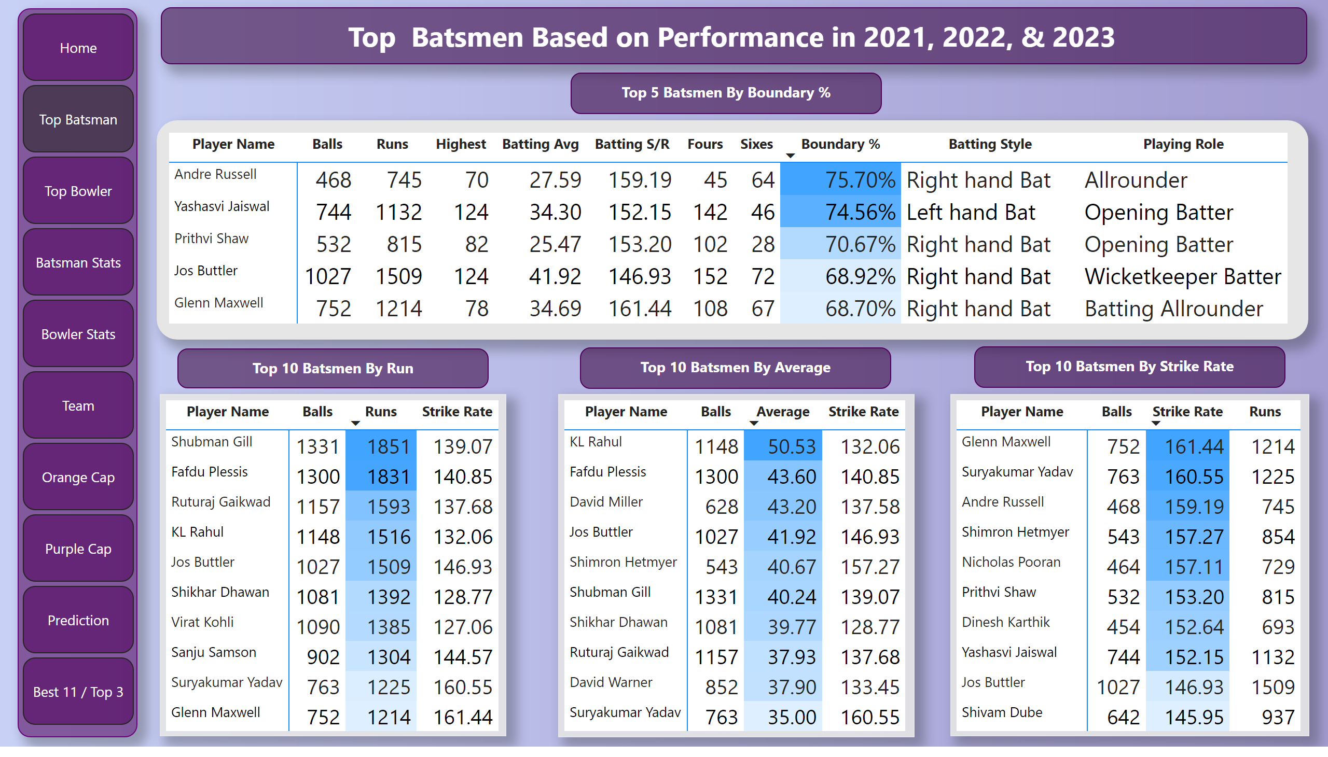
Top Batsman
Notes:
pivotTable
No alt text provided
pivotTable
No alt text provided
pivotTable
No alt text provided
pivotTable
No alt text provided
textbox
No alt text provided
textbox
No alt text provided
textbox
No alt text provided
textbox
No alt text provided
textbox
No alt text provided
pageNavigator
No alt text provided

Slide 7
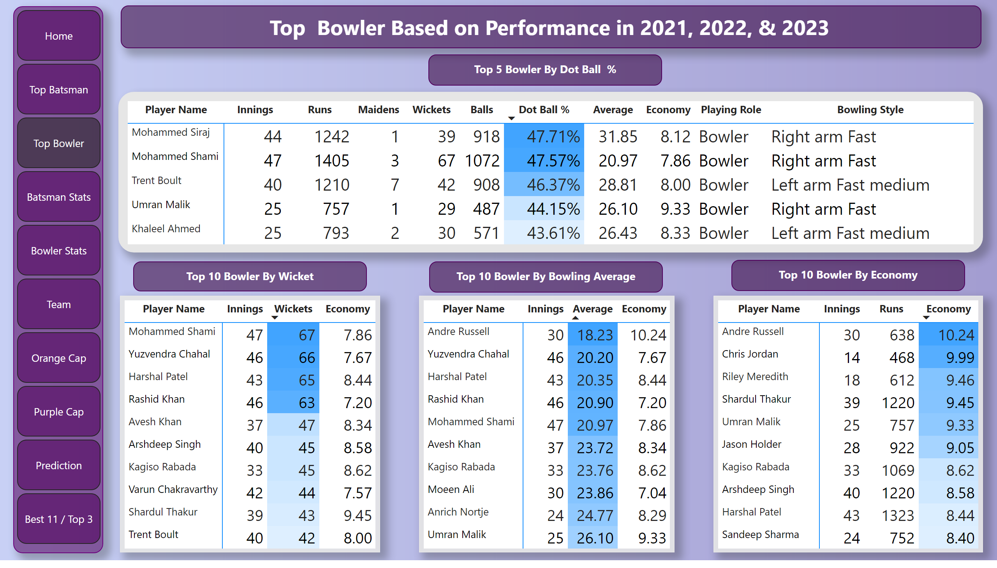
Top Bowler
Notes:
pivotTable
No alt text provided
pivotTable
No alt text provided
pivotTable
No alt text provided
pivotTable
No alt text provided
textbox
No alt text provided
textbox
No alt text provided
textbox
No alt text provided
textbox
No alt text provided
textbox
No alt text provided
pageNavigator
No alt text provided

Slide 8
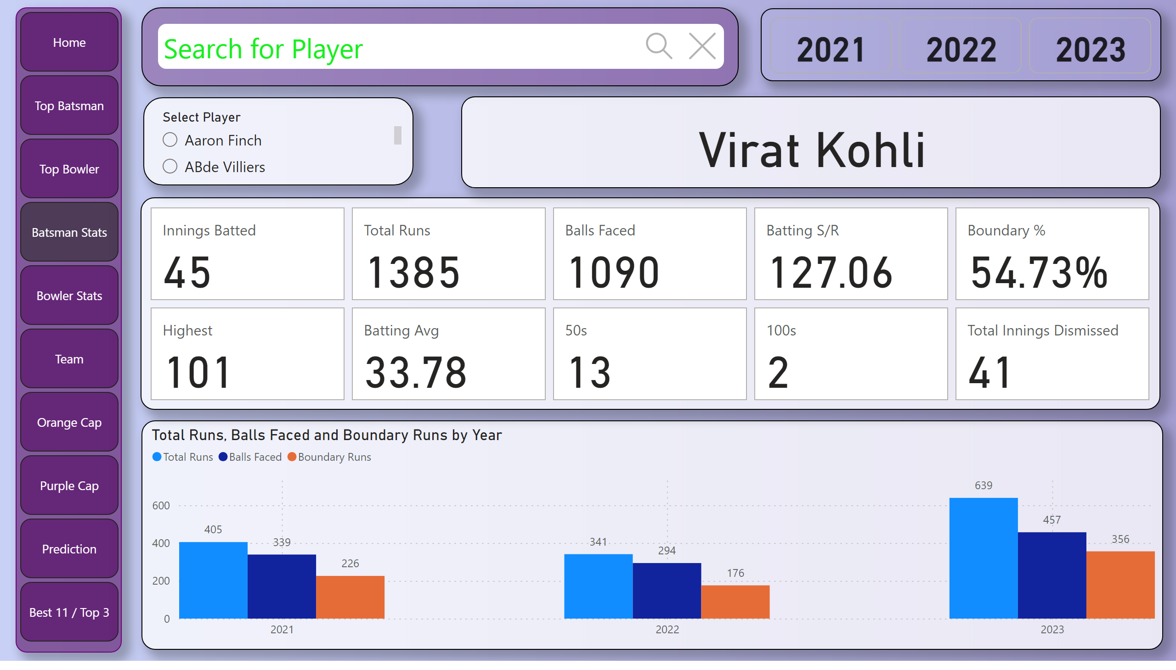
Batsman Stats
Notes:
textSearchSlicerF85E2E78BE4A4D7D9F99ED75B5D71C85
No alt text provided
advancedSlicerVisual
No alt text provided
clusteredColumnChart
No alt text provided
cardVisual
No alt text provided
slicer
No alt text provided
card
No alt text provided
pageNavigator
No alt text provided

Slide 9
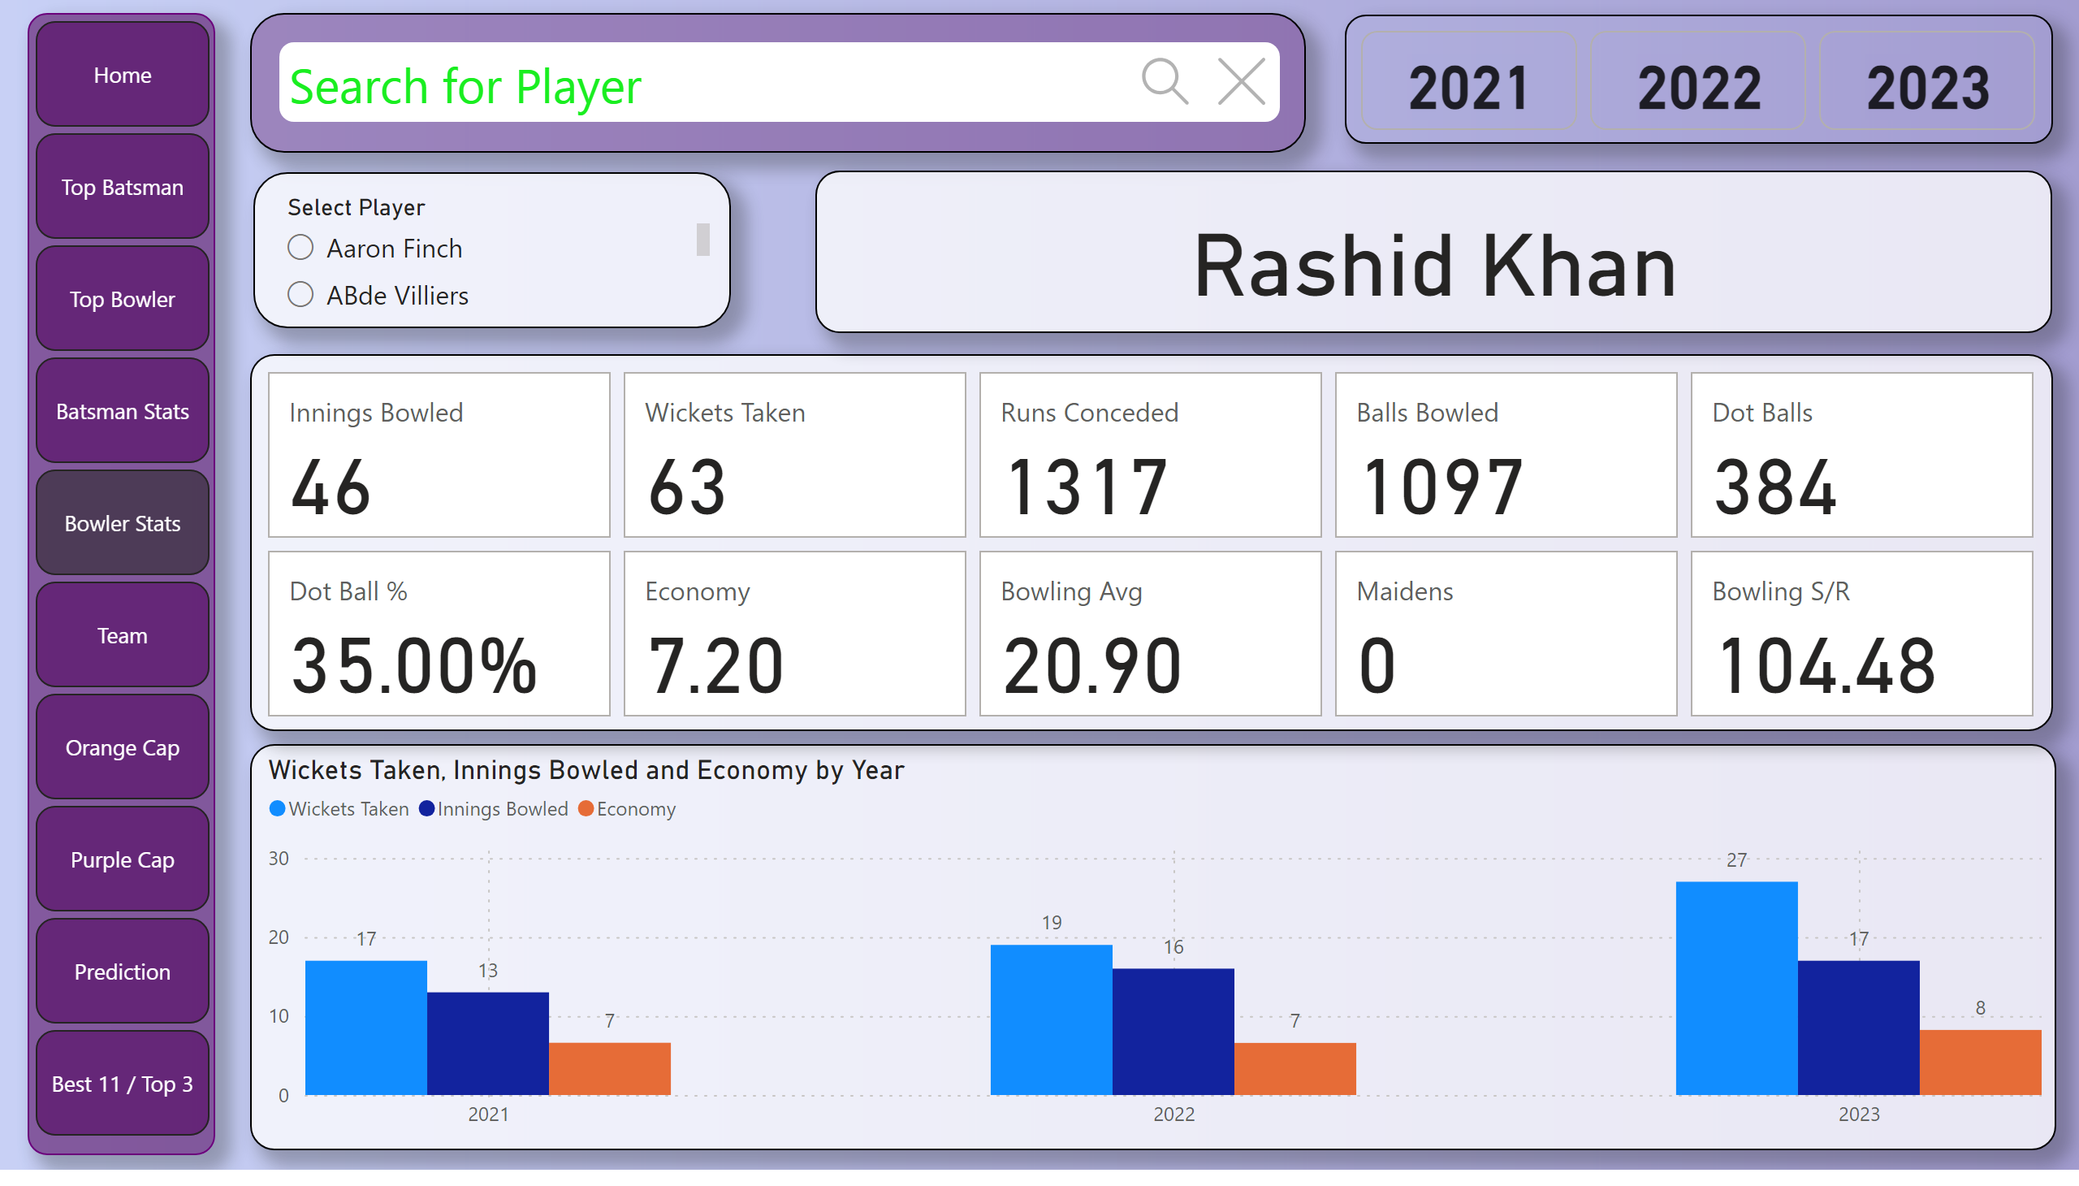
Bowler Stats
Notes:
clusteredColumnChart
No alt text provided
cardVisual
No alt text provided
slicer
No alt text provided
card
No alt text provided
advancedSlicerVisual
No alt text provided
textSearchSlicerF85E2E78BE4A4D7D9F99ED75B5D71C85
No alt text provided
pageNavigator
No alt text provided

Slide 10
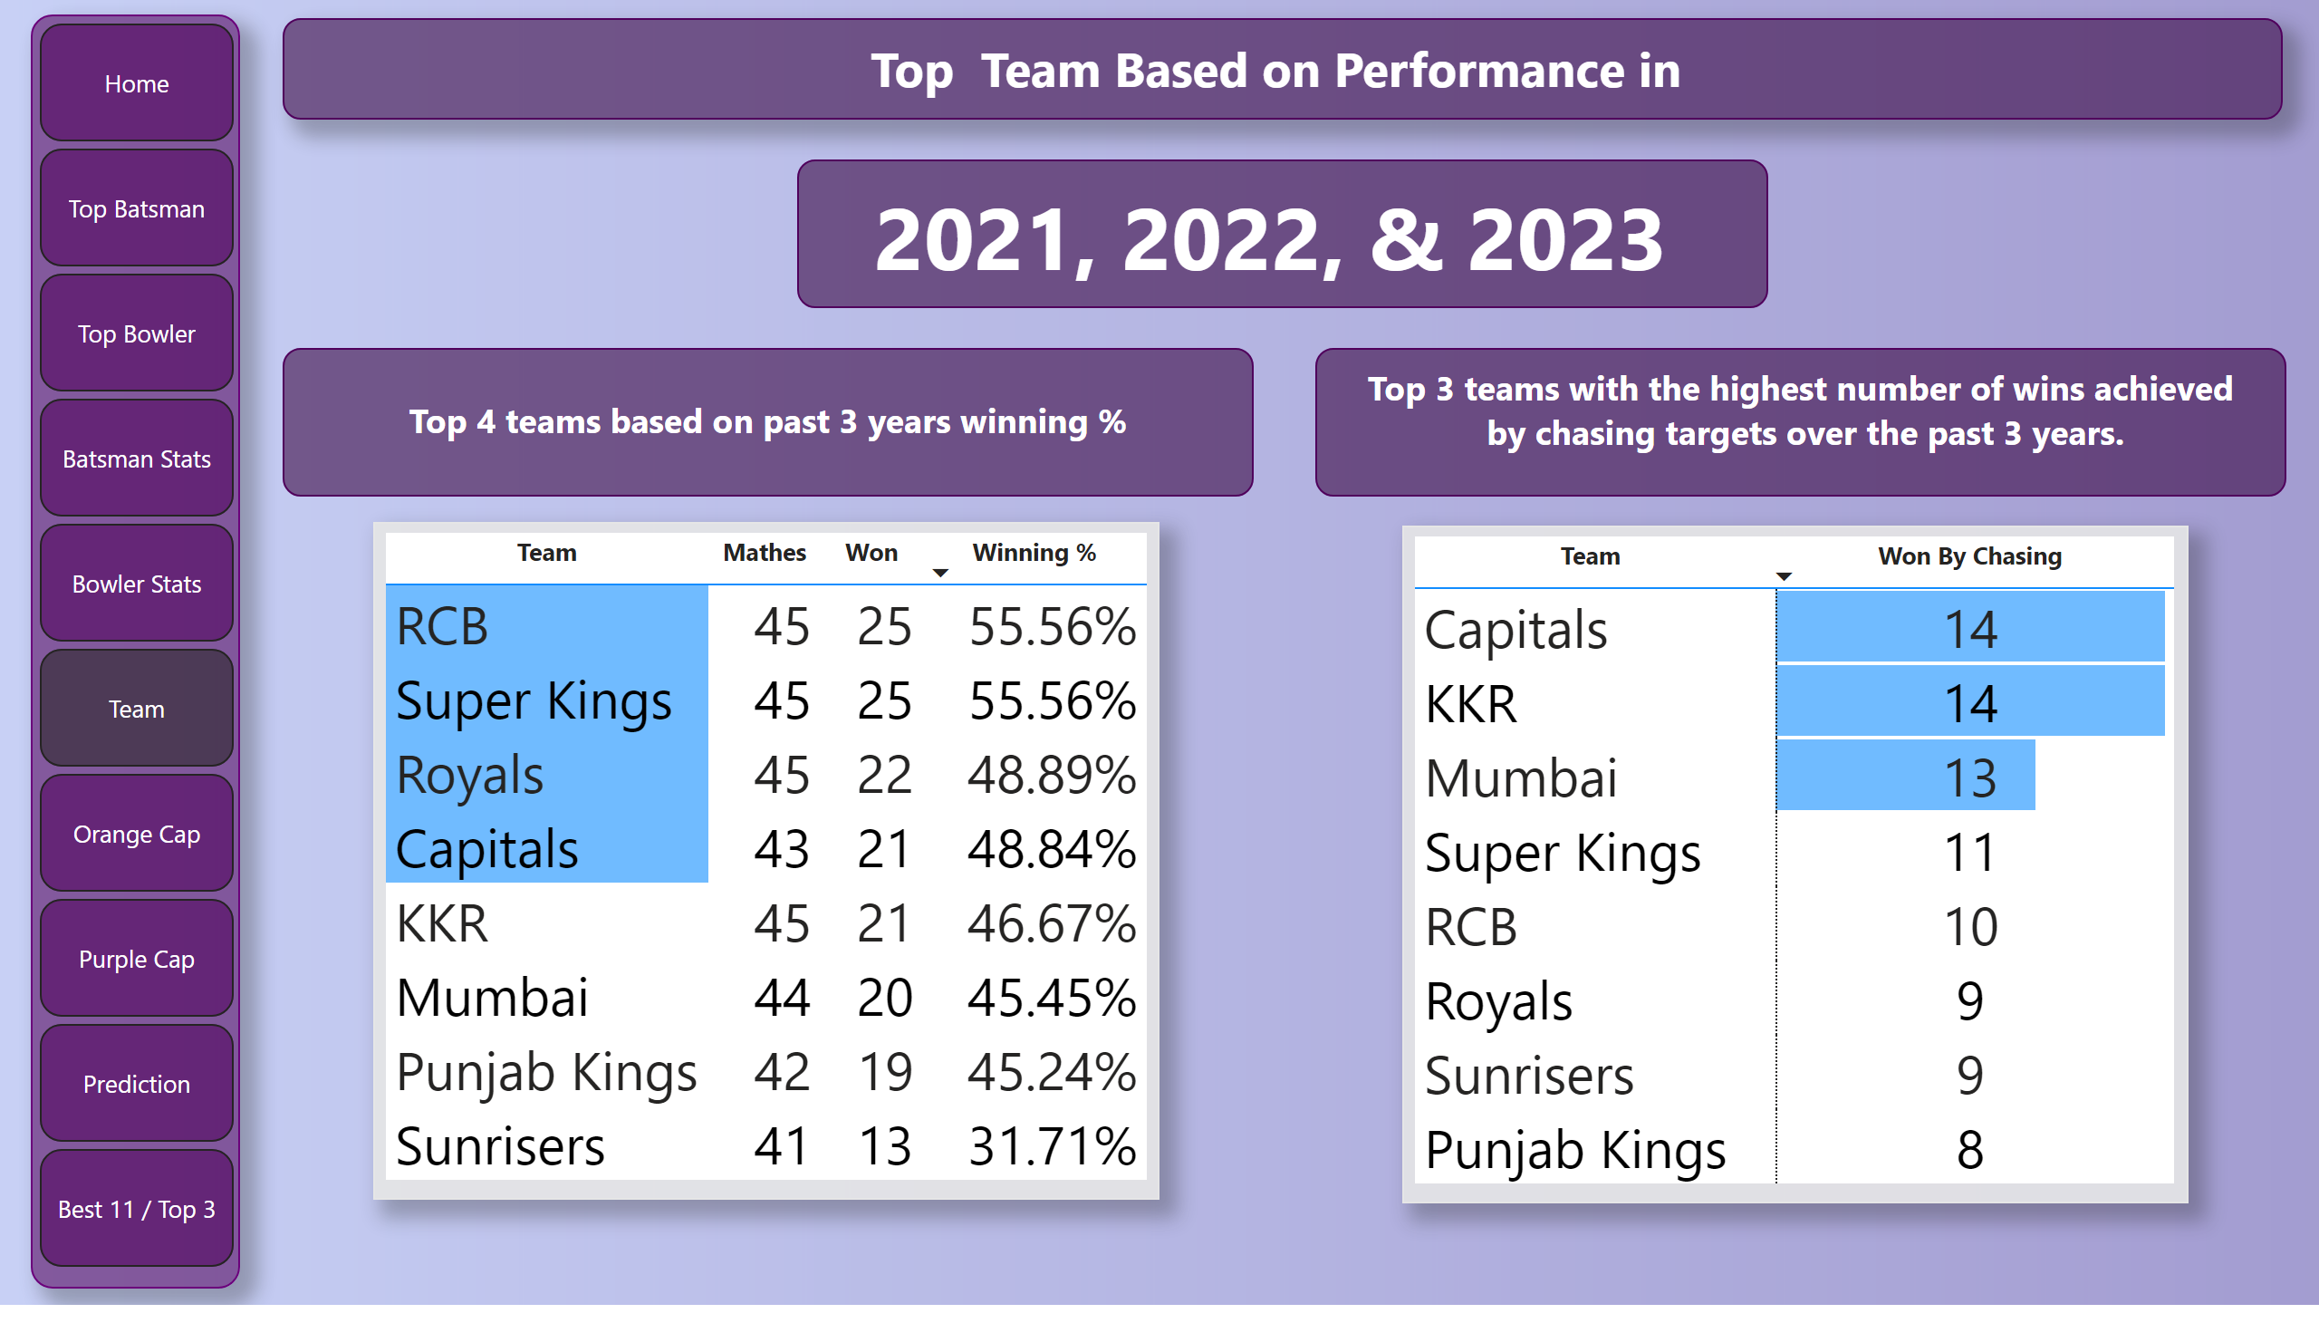
Team
Notes:
textbox
No alt text provided
textbox
No alt text provided
tableEx
No alt text provided
tableEx
No alt text provided
textbox
No alt text provided
textbox
No alt text provided
pageNavigator
No alt text provided

Slide 11
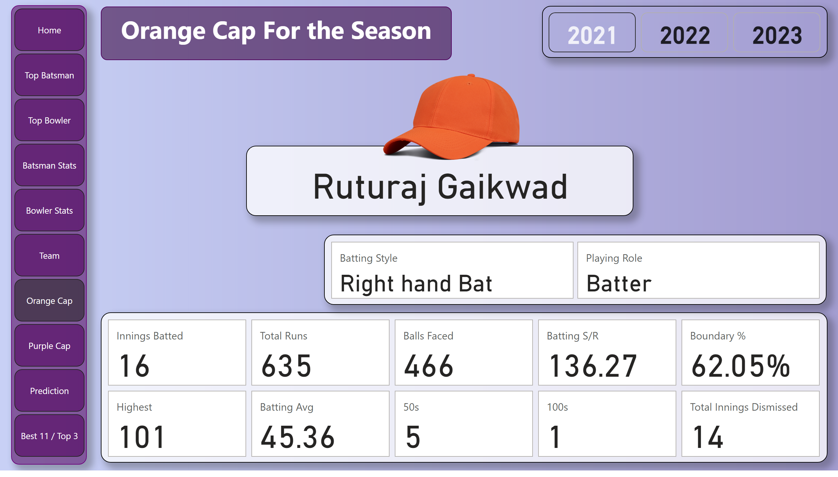
Orange Cap
Notes:
advancedSlicerVisual
No alt text provided
cardVisual
No alt text provided
textbox
No alt text provided
card
No alt text provided
cardVisual
No alt text provided
image
No alt text provided
pageNavigator
No alt text provided

Slide 12
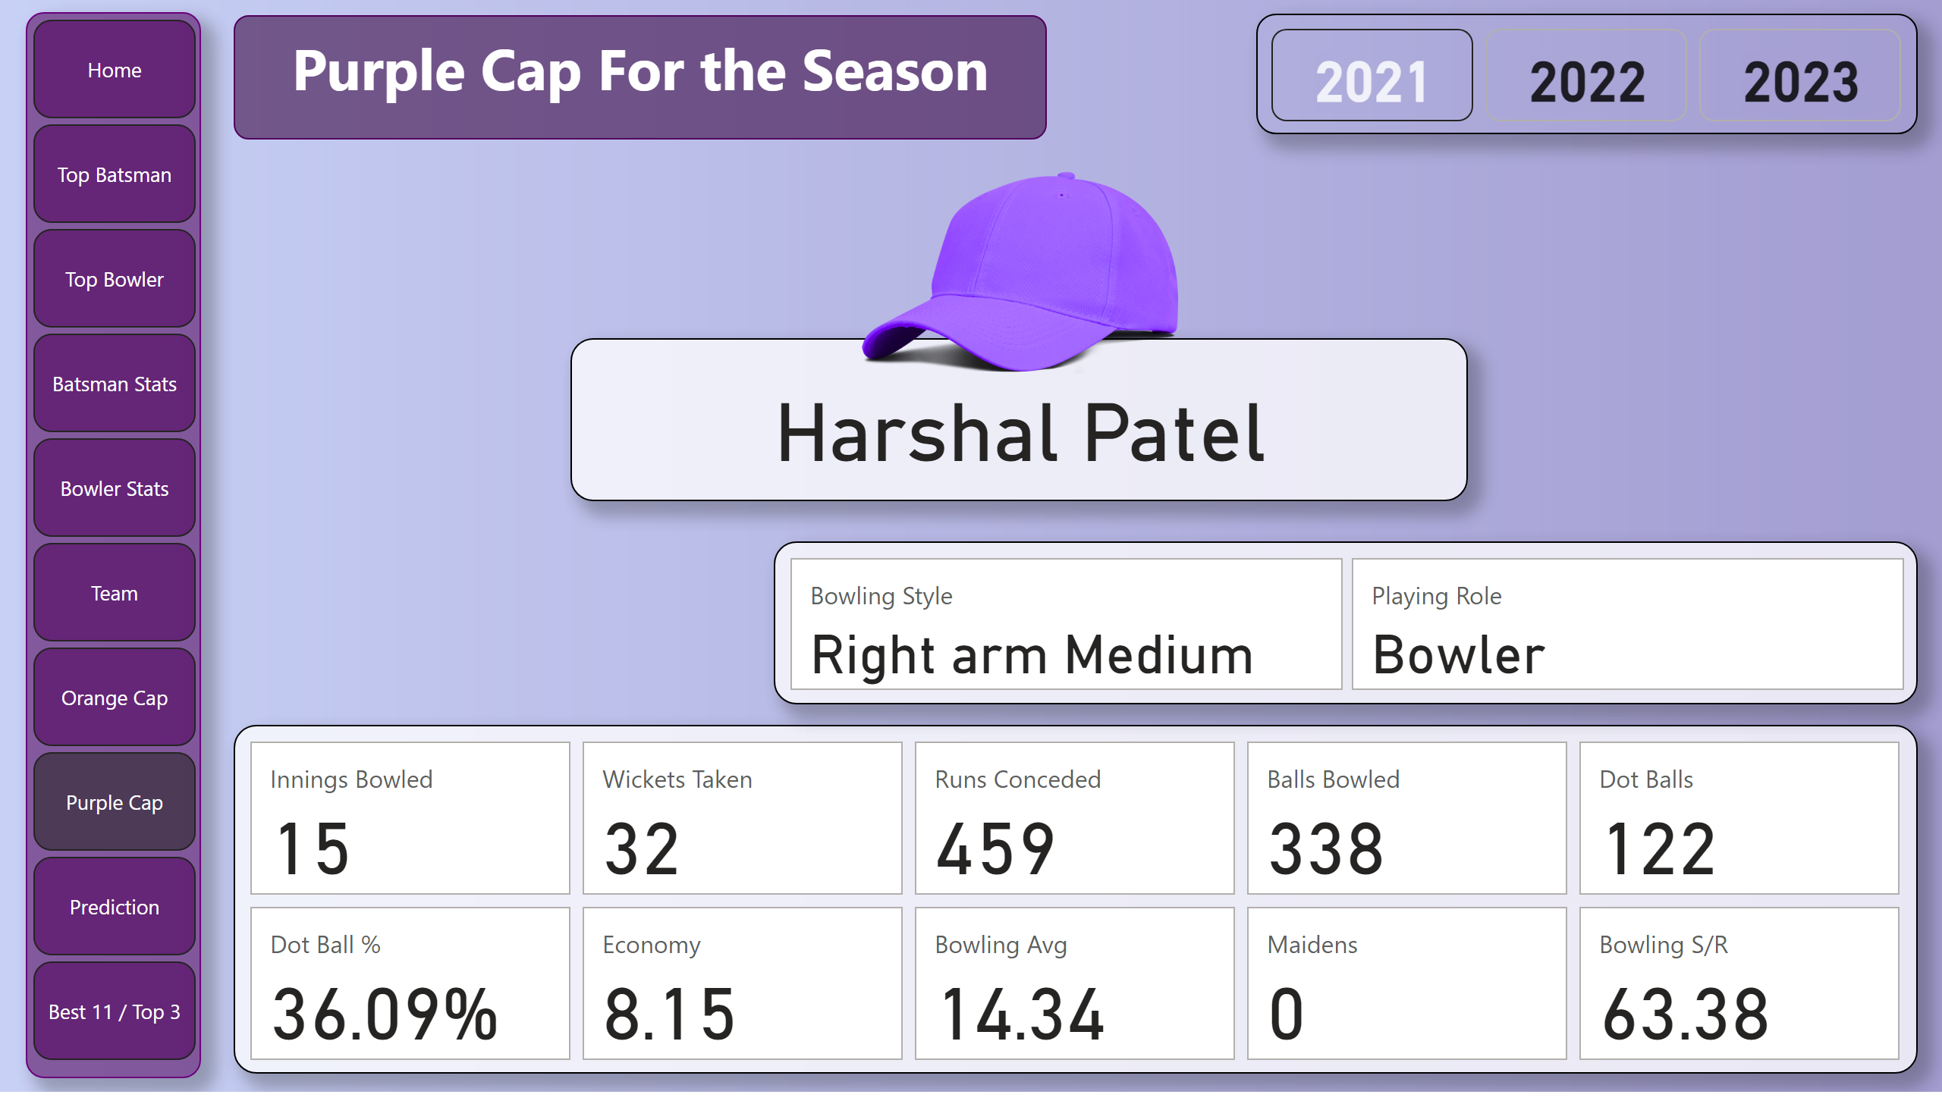
Purple Cap
Notes:
advancedSlicerVisual
No alt text provided
cardVisual
No alt text provided
textbox
No alt text provided
card
No alt text provided
cardVisual
No alt text provided
image
No alt text provided
pageNavigator
No alt text provided

Slide 13
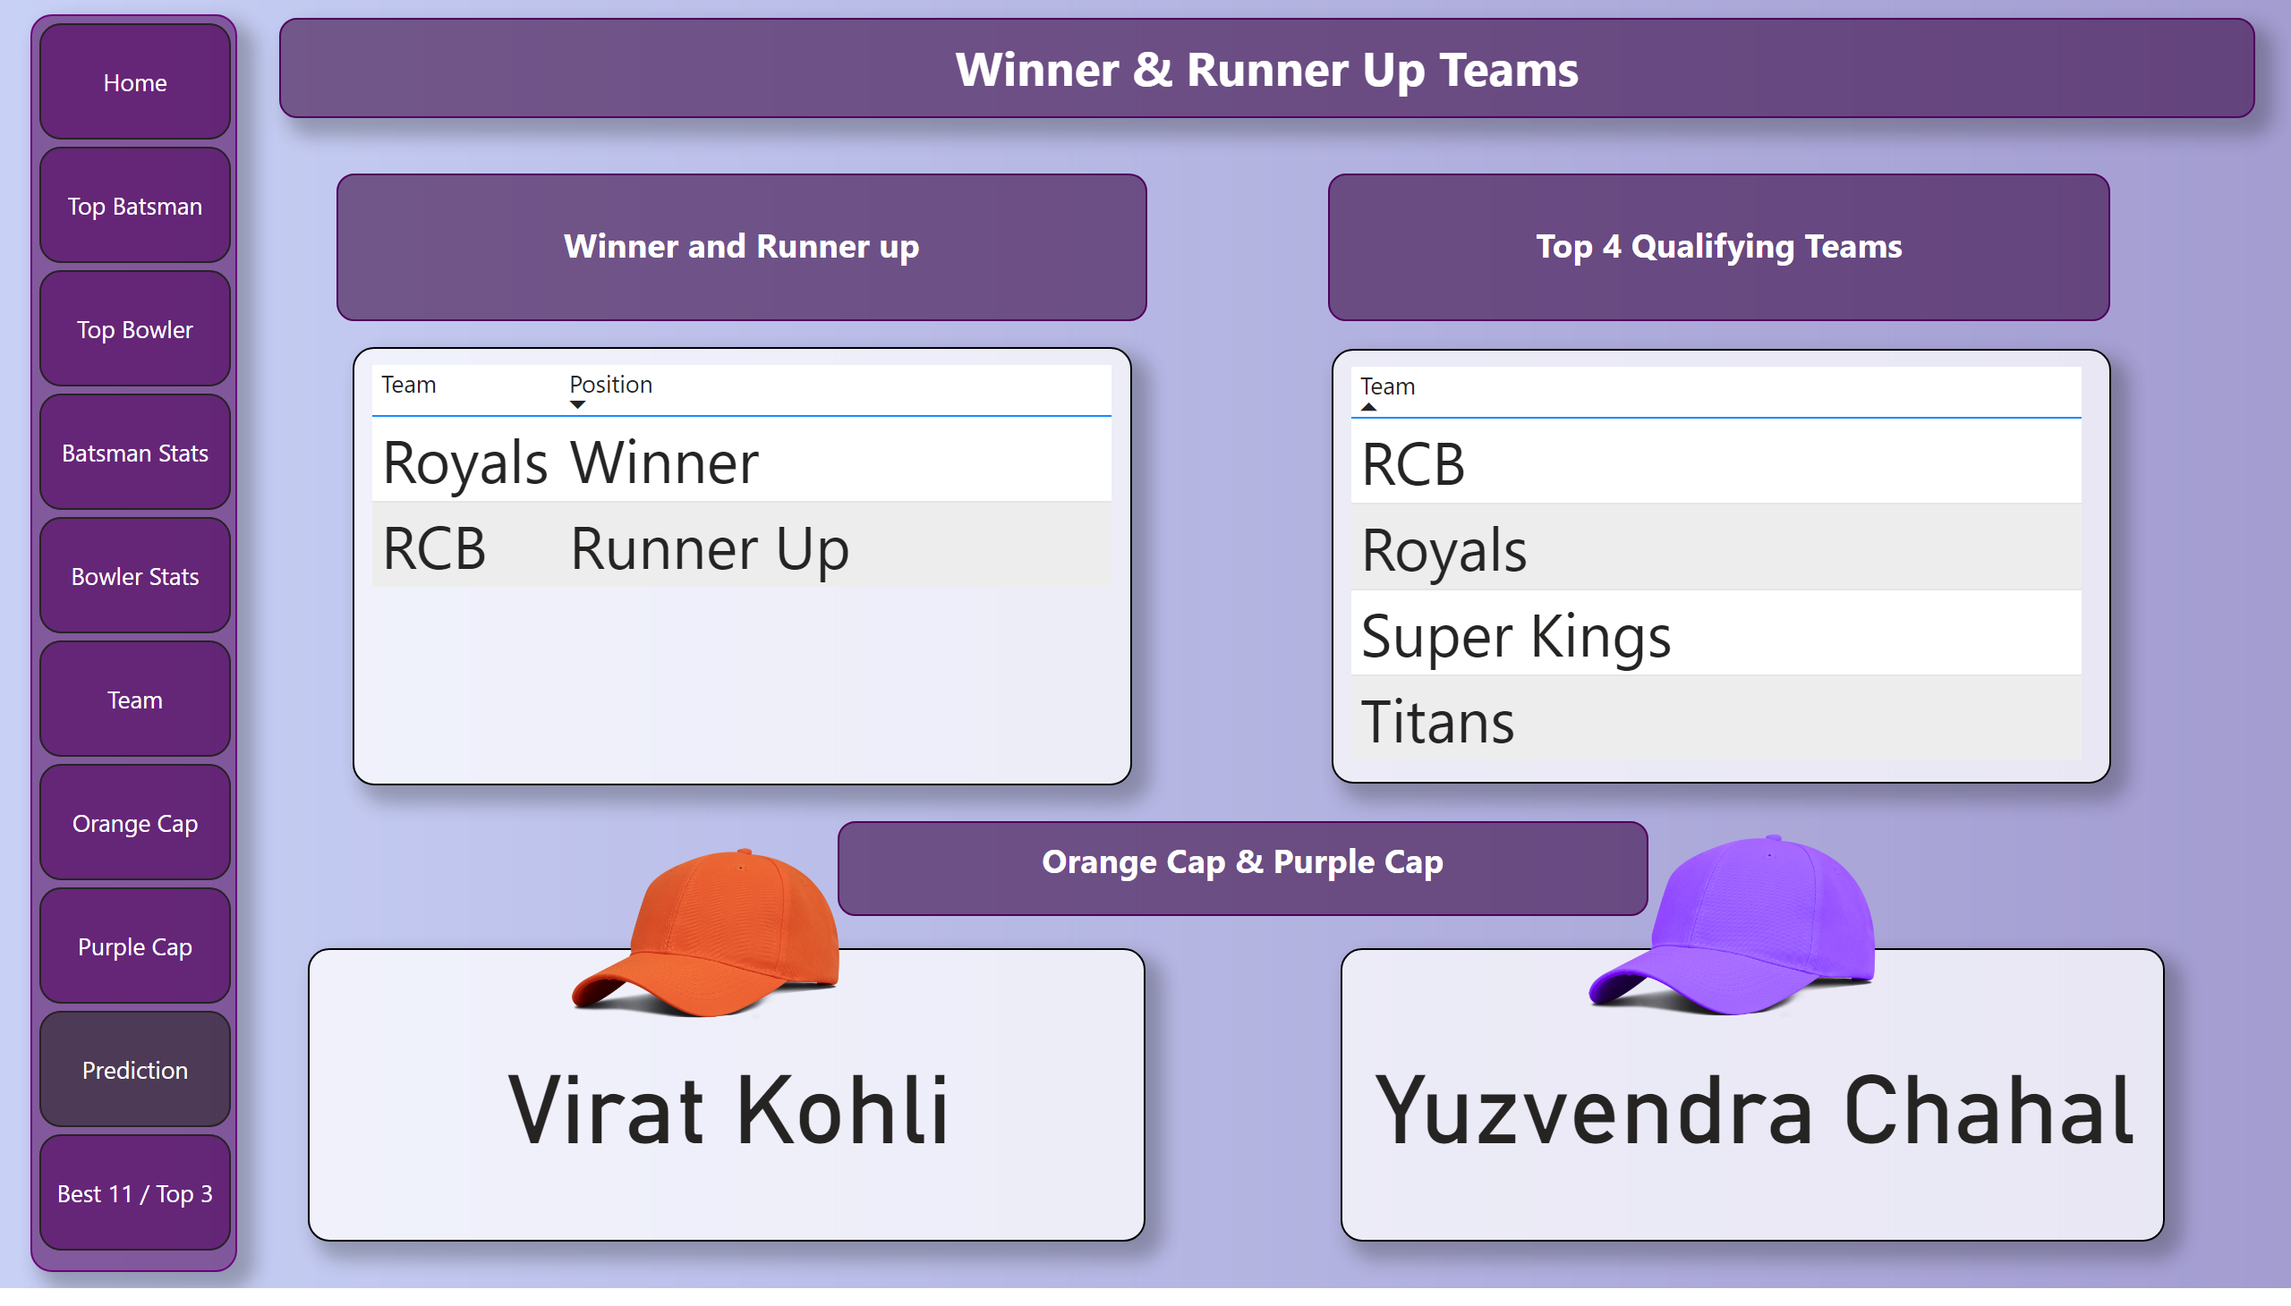
Prediction
Notes:
pageNavigator
No alt text provided
tableEx
No alt text provided
tableEx
No alt text provided
textbox
No alt text provided
textbox
No alt text provided
textbox
No alt text provided
textbox
No alt text provided
card
No alt text provided
card
No alt text provided
image
No alt text provided
image
No alt text provided

Slide 14
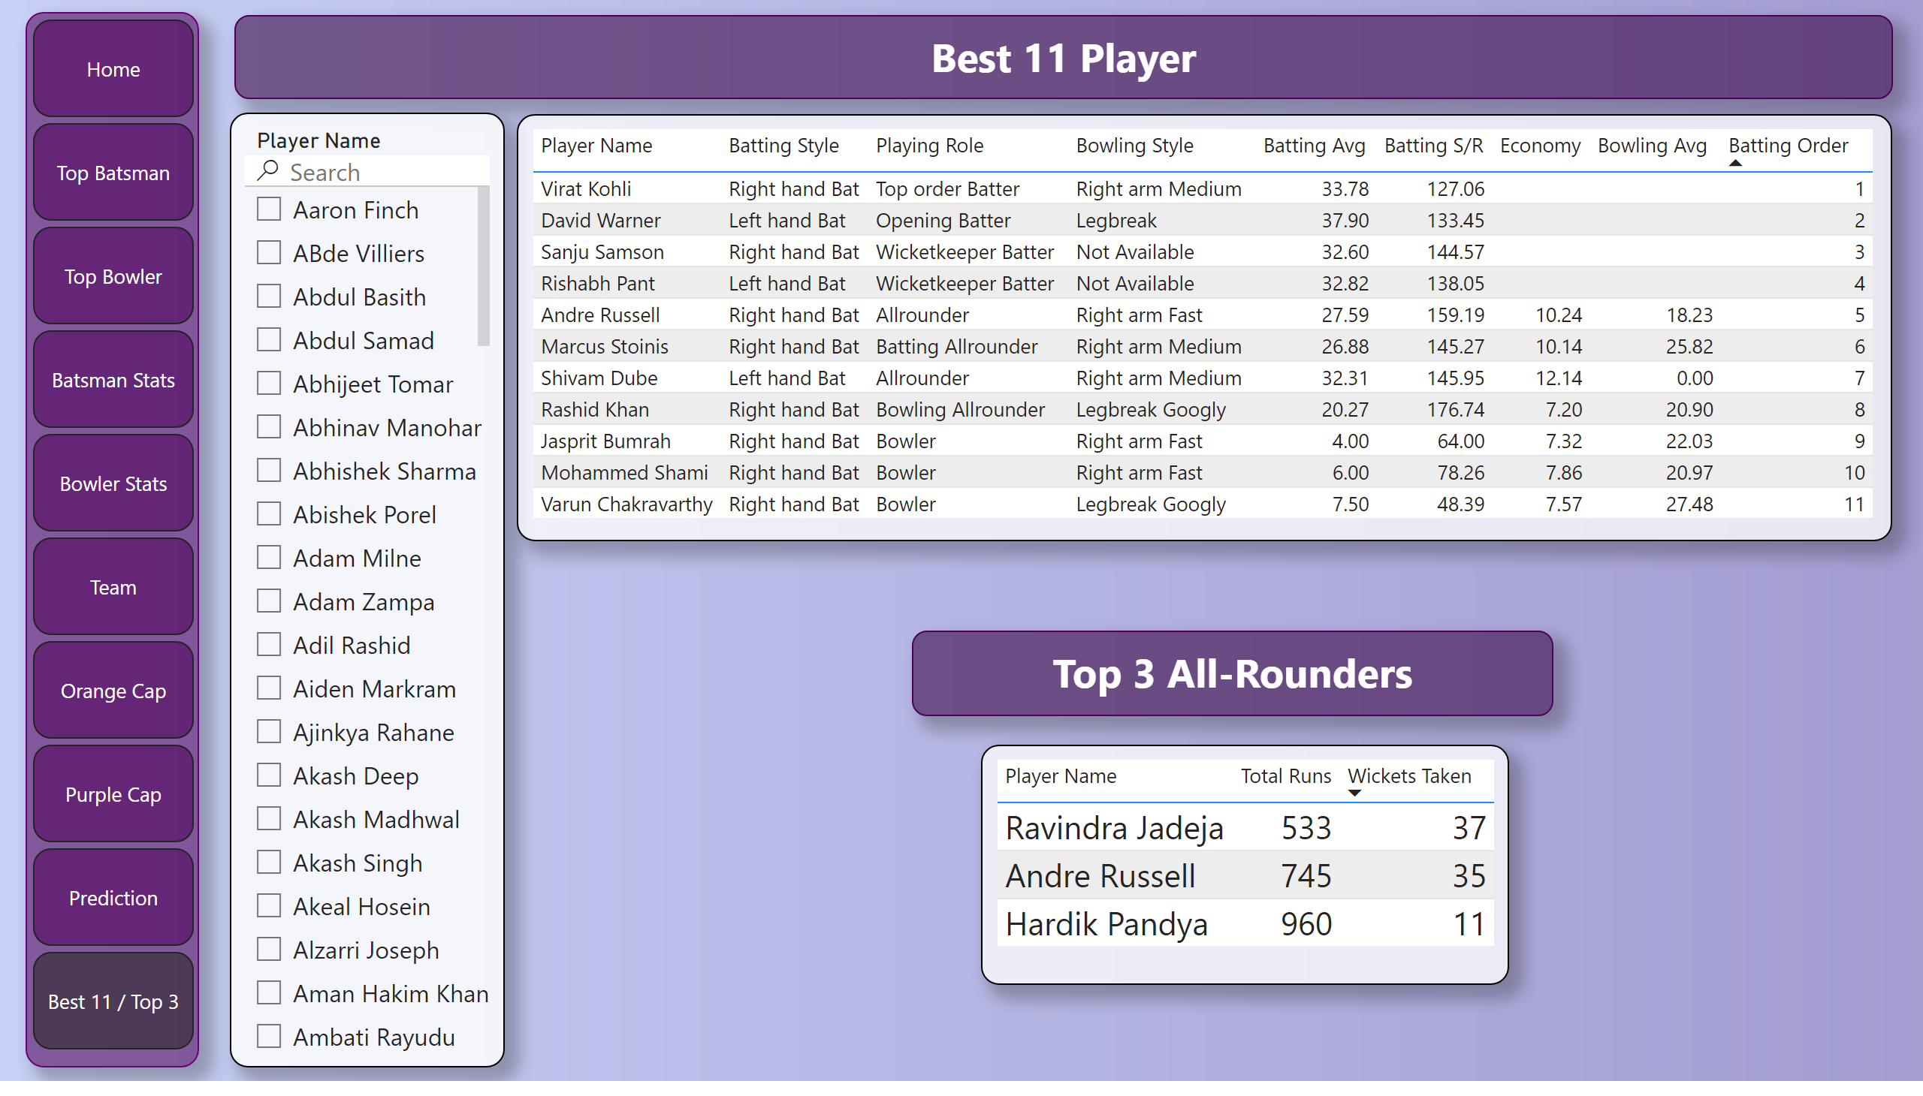
Best 11 / Top 3
Notes:
textbox
No alt text provided
pageNavigator
No alt text provided
slicer
No alt text provided
tableEx
No alt text provided
tableEx
No alt text provided
textbox
No alt text provided

Slide 15
Conclusion
Data analytics enhances content quality, providing cricket enthusiasts with compelling insights and narratives.
It enriches understanding and engagement, establishing the magazine as a trusted source for IPL enthusiasts.

Slide 16
Thank You
for your attention and interest in the "Sports Basics" IPL 2024 Magazine Insights.

